Slide 1

Programming in C Language - Part 2
Veritas University, Abuja, Nigeria

Slide 2
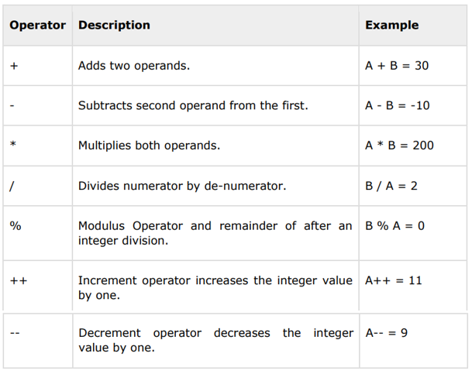
Arithmetic Operators
The following table shows all the arithmetic operators supported by the C language.
Assume;
variable A holds 10
variable B holds 20

Slide 3
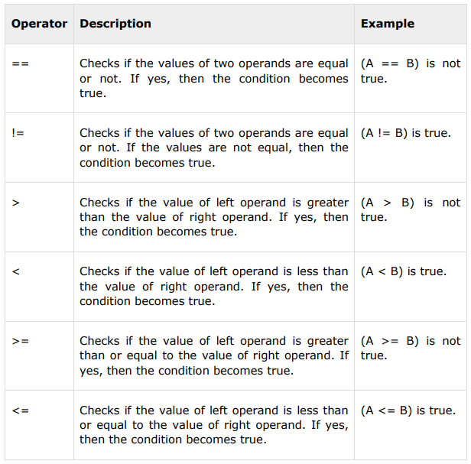
Relational operators
The following table shows all the relational operators supported by C.
Assume;
variable A holds 10
variable B holds 20

Slide 4
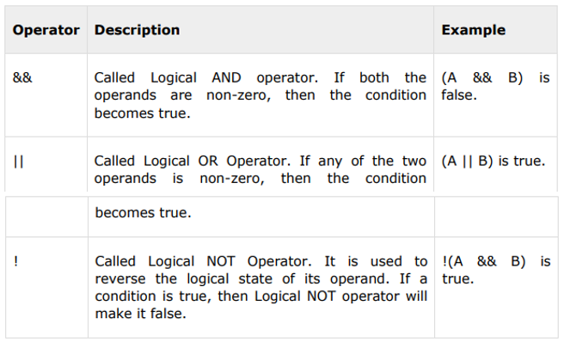
Logical Operators
Following table shows all the logical operators supported by C language.
Assume;
variable A holds 1
variable B holds 0

Slide 5
Relational operators
#include <stdio.h>
int main ()
{
int a = 21;
int b = 10;
int c ;
if( a == b ) {
printf("Line 1 - a is equal to b\n" );
}
else {
printf("Line 1 - a is not equal to b\n" );
}
if ( a < b ) {
printf("Line 2 - a is less than b\n" );
}
else {
printf("Line 2 - a is not less than b\n" );
}
return 0;
}
Combining Logical and relational operators
#include <stdio.h>
int main ()
{
int a = 5;
int b = 5;
int c = 10;
if ( (a==5) && (c>5) ) {
printf("Line 1 – c is greater than 5\n" );
}
return 0;
}

Slide 6
If-else statement
Example 1:
if (x < y)
y = x;
Example 2:
if (x < y)
y = x;
else
y += 7;
Compound Statements are multiple statements grouped within curly braces.
Example:
if (x < y) {
y = x;
x *= 2;
}
else {
y += 7;
--x;
}
Chained if-else Statements are multiple interlinked if-else statements.
if (x < y)
printf(“x is less than y. \n");
else
if (x == y)
printf(“x is same value as y.\n");
else {
printf(“x is not less than y. \n");
printf(“x is also not equal to y. \n");
printf(“x must be greater than y. \n");
}

Slide 7
If-else statement cont’d..
A common mistake with if-else blocks is the “dangling else problem”. For example, consider the following nested-if statement.
Example:
if (x < y)
if (m != 0)
y = x;
else x = z;
Programmer desires to assign the else to the first if. However, it will be allocated to the inner ‘if’.
Example:
if (a < b) {
if (m != 0)
b = a;
}
else
a = m;
Use curly brackets to enforce association.

Slide 8
Conditional expression: The ‘?’ Operator
The conditional expression is a ternary operator; that is, it takes three operands.
It has the following form
(expression 1) ? (expression 2) : (expression 3)
The value of a ? expression is determined like this:
Exp1 is evaluated. If it is true, then Exp2 is evaluated and becomes the value of the entire ? expression.
If Exp1 is false, then Exp3 is evaluated and its value becomes the value of the expression.
For example, to calculate the maximum of two values,
c = (a > b) ? a : b;
If a is greater than b then c = a. Else, c = b.

Slide 9
Conditional Expression cont’d…
int a, b, c;
a = 10;
b = 30;
c = (a < b) ? (a * b) : (b/a);
printf(“c = %d”, c)
Output
c = 300; ;(a * b) will be executed because
;(a<b) is true
int a, b, c;
a = 10;
b = 30;
c = (a > b) ? (a * b) : (b/a);
printf(“c = %d”, c)
Output
c = 3; ;(b/a) will be executed because ;(a>b) is false

Slide 10
Switch statement
A switch statement allows a variable to be tested for equality against a list of values. Each value is called a case, and the variable being switched on is checked for each switch case.
switch(expression){
case constant-expression :
statement(s);
break; /* optional */
case constant-expression :
statement(s);
break; /* optional */
/* you can have any number of case statements */
default : /* Optional */
statement(s);
}

Slide 11
Switch statement cont’d…
The expression used in a switch statement must have an integral or enumerated type, or be of a class type in which the class has a single conversion function to an integral or enumerated type.
The constant-expression for a case must be the same data type as the variable in the switch, and it must be a constant or a literal.
When the variable being switched on is equal to a case, the statements following that case will execute until a break statement is reached.
When a break statement is reached, the switch terminates, and the flow of control jumps to the next line following the switch statement.

Slide 12
Switch statement cont’d…
#include <stdio.h>
int main ()
{
/* local variable definition */
char grade = 'B';
switch(grade)
{
case 'A' :
printf("Excellent!\n" );
break;
case 'B' :
printf(“Very Good grade \n”);
break;
case 'C' :
printf("Well done\n" );
break;
case 'D' :
printf("You passed\n" );
break;
case 'F' : printf("Better try again\n" );
break;
default :
printf("Invalid grade\n" );
}
printf("Your grade is %c\n", grade );
return 0;
}
Break is optional.
A switch statement can have an optional default case, which must appear at the end of the switch.
The default case can be used for performing a task when none of the cases is true. No break is needed in the default case.

Slide 13
Switch statement cont’d…
#include <stdio.h>
int main ()
{
/* local variable definition */
int a = 100;
int b = 200;
switch(a) {
case 100:
printf("This is part of outer switch\n", a );
switch(b) {
case 200:
printf("This is part of inner switch\n", a );
}
}
printf("Exact value of a is : %d\n", a );
printf("Exact value of b is : %d\n", b );
return 0;
}

Slide 14
While Loop
#include <stdio.h>
int main ()
{
int a = 10;
while( a < 20 )
{
printf("value of a: %d\n", a);
a++;
}
return 0;
}
Output:
value of a: 10
value of a: 11
value of a: 12
value of a: 13
value of a: 14
value of a: 15
value of a: 16
value of a: 17
value of a: 18
value of a: 19
A while loop repeatedly executes a statement as long as a given condition is true.

Slide 15
For loop
A for loop is a statement that allows you to write a loop that needs to execute a specific number of times.
For loop format:
for ( initialize; condition; increment )
{
statement(s);
}
#include <stdio.h>
int main ()
{
for( int a = 10; a < 20; a = a + 1 )
{
printf("value of a: %d\n", a);
}
return 0;
}
Output:
value of a: 10
value of a: 11
value of a: 12
value of a: 13
value of a: 14
value of a: 15
value of a: 16
value of a: 17
value of a: 18
value of a: 19

Slide 16
Do while Loop
Unlike for and while loops, which test the loop condition at the top of the loop, the do...while loop in C programming checks its condition at the bottom of the loop.
A do-while loop is similar to a while loop, except the fact that it is guaranteed to execute at least one time.
do {
statement(s);
}
while( condition );
#include <stdio.h>
int main ()
{
int a = 10;
do {
printf("value of a: %d\n", a);
a = a + 1;
}
while( a < 20 );
return 0;
}
Output:
value of a: 10
value of a: 11
value of a: 12
value of a: 13
value of a: 14
value of a: 15
value of a: 16
value of a: 17
value of a: 18
value of a: 19

Slide 17
Infinite loop
An infinite loop is a loop that runs forever.
A loop becomes an infinite loop if a condition never becomes false.
The for loop is usually infinite loops.
An infinite loop can be made by leaving the conditional expression empty.
#include <stdio.h>
int main ()
{
for( ; ; )
{
printf("This loop will run forever.\n");
}
return 0;
}

Slide 18

printf() and scanf() in C
The printf() and scanf() functions are used for input and output in C language. Both functions are inbuilt library functions, defined in stdio.h (header file).
printf() function
The printf() function is used for output. It prints the given statement to the console.
The format string can be %d (integer), %c (character), %s (string), %f (float) etc.

Slide 19
scanf() function
The scanf() function is used for input. It reads the input data from the console.

Slide 20
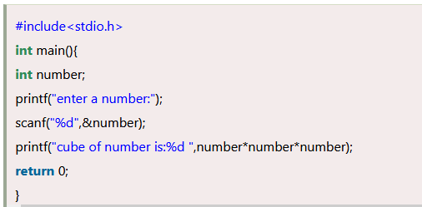
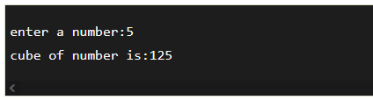
Program to print cube of given number
Let's see a simple example of c language that gets input from the user and prints the cube of the given number.
The scanf("%d",&number) statement reads integer number from the console and stores the given value in number variable.
The printf("cube of number is:%d ",number*number*number) statement prints the cube of number on the console.

Slide 21
